Slide 1
Manchester SAFT
Overview

Slide 2
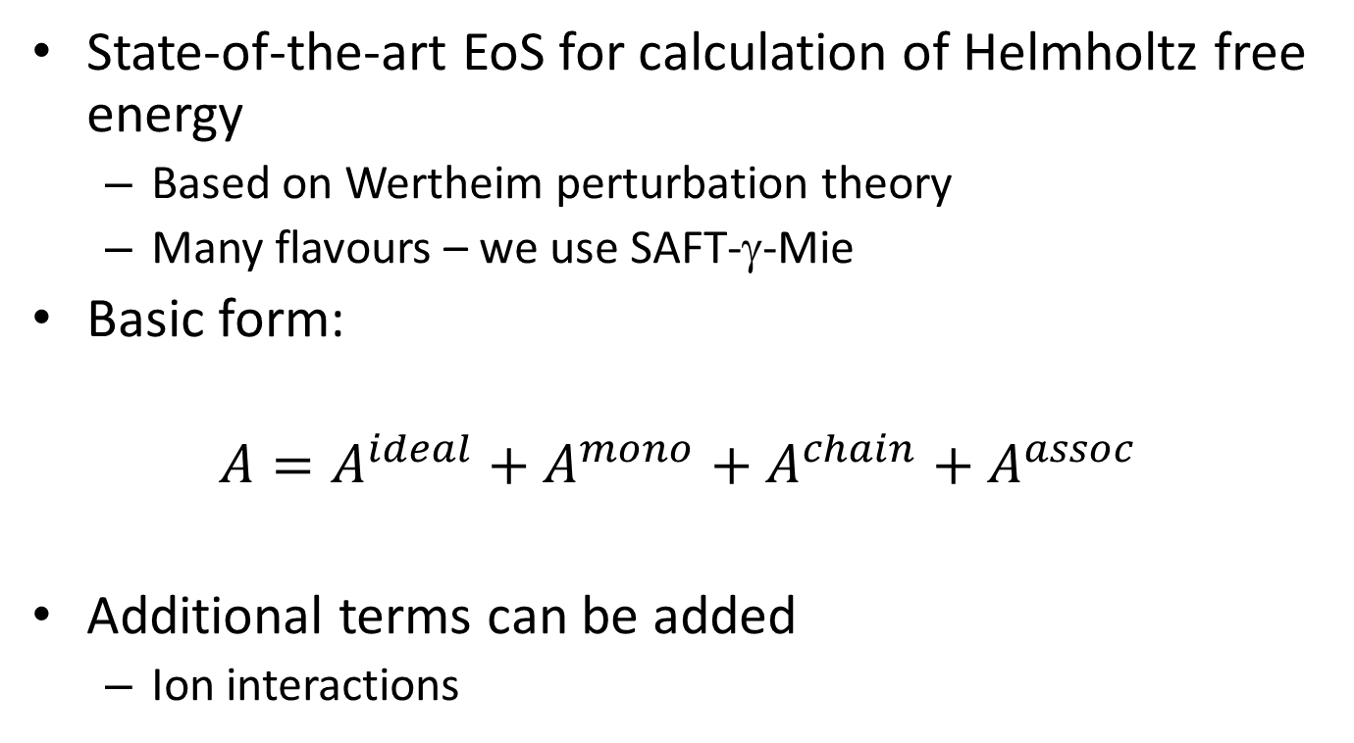
What is SAFT?
State-of-the-art EoS for calculation of Helmholtz free energy
Based on Wertheim perturbation theory
Many flavours – we use SAFT-γ-Mie
Basic form:
$$A=A^{ideal}+A^{mono}+A^{chain}+A^{assoc}$$
Additional terms can be added
Ion interactions

Slide 3
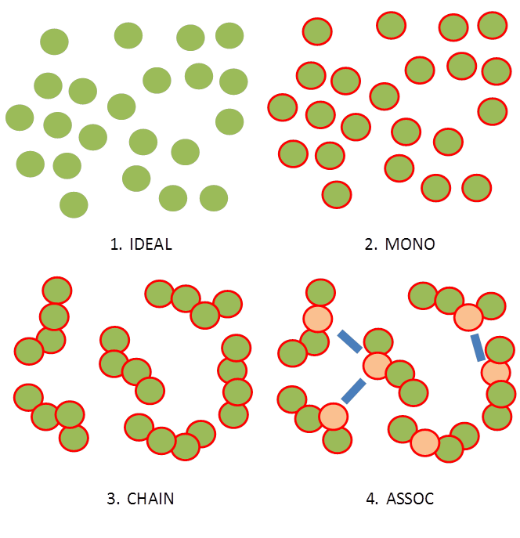
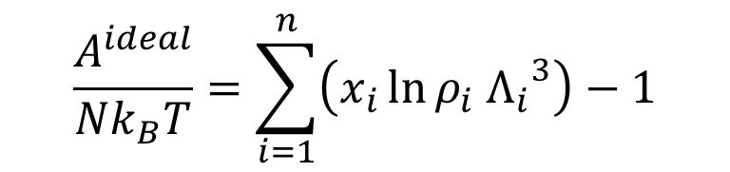
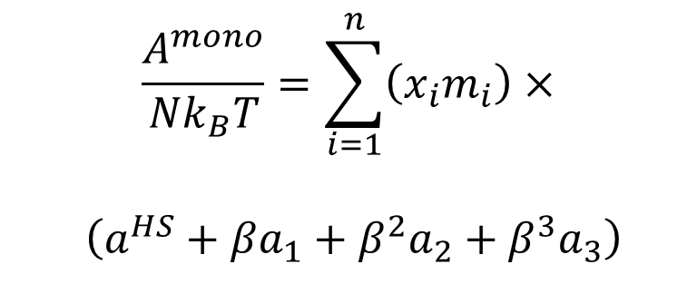
$$\frac{A^{ideal}}{{Nk}_{B}T}=\sum_{i=1}^{n}{\left(x_{i}\ln{ρ_{i} {Λ_{i}}^{3}}\right)}−1$$
$$\frac{A^{mono}}{{Nk}_{B}T}=\sum_{i=1}^{n}{\left(x_{i}m_{i}\right)}×$$
$$\left(a^{HS}+βa_{1}+β^{2}a_{2}+β^{3}a_{3}\right)$$

Slide 4
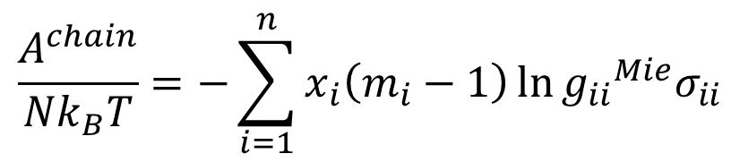
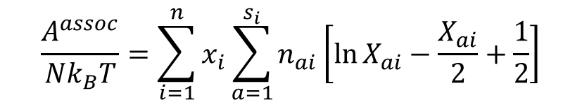
$$\frac{A^{chain}}{{Nk}_{B}T}=−\sum_{i=1}^{n}{x_{i}\left(m_{i}−1\right)}\ln{{g_{ii}}^{Mie}σ_{ii}}$$
$$\frac{A^{assoc}}{{Nk}_{B}T}=\sum_{i=1}^{n}{x_{i}\sum_{a=1}^{s_{i}}{n_{ai}\left[\ln{X_{ai}}−\frac{X_{ai}}{2}+\frac{1}{2}\right]}}$$

Slide 5

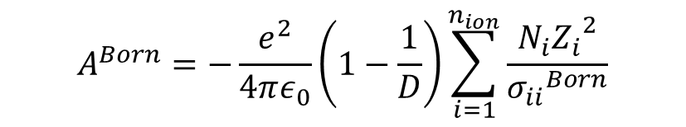
For current project, also require ion-ion interactions
This comes in two parts at present
A^{Born}
A Born term for the ion-solvent interactions
A^{ion}
Term for ion-ion interactions
$$A^{Born}=−\frac{e^{2}}{4πε_{0}}\left(1−\frac{1}{D}\right)\sum_{i=1}^{n_{ion}}{\frac{N_{i}{Z_{i}}^{2}}{{σ_{ii}}^{Born}}}$$
$$A^{ion}=U^{MSA}+\frac{Γ^{3}k_{B}TV}{3π}$$

Slide 6
Program structure
PHASE_SIMPLEX
TYPES
ACT_ION
MAIN
SETUP
GLOBAL
PURE_PHASE
IDEAL
INPUT
GL
THERM
QUOTE
MONO
OPTIMISER
PRESS
CHAIN
ZIG
MU
ASSOC
INPUT_OPT
VOL
ION
ZEFF
SIMPLEX
DIFF
ERROR

Slide 7
Program structure
Written in modules following FORTRAN standards
Modular design means
Straightforward to find specific sections of code
Simple to edit individual parts
Many sections essentially “black boxes”
Can write new driver program to interface with other software

Slide 8
Program structure
Most parts are self-explanatory from names, and comments should be included
Some specific ones:
Main
This is the main program which reads input, performs requested calculation and prints output
Optimiser
This is the main program for running a parameter optimisation
Global_mod
This contains a list of globally used variables
This saves passing large numbers of variables between modules!

Slide 9
Capabilities
Many properties can be calculated from SAFT
It is often straightforward to add modules for other properties
Currently included in this version:
Derivatives of A w.r.t. V and N are fully analytical (Diff_mod)
Pressures and chemical potentials are precise (as is volume!)
Other derivatives are numerical
Pressure | Volume | Pure VLE
Parameter optimisation | Activity coefficient | Binary VLE
Chemical potential | Thermodynamic properties | C_{P}

Slide 10
Parameters
SAFT-γ-Mie has quite a few parameters:
σ
ε (ii / ij)
λ^{r} (ii / ij)
λª
Sf
N_{seg}
mass
E^{HB} (ii / ij)
K^{HB} (ii / ij)
dv
dt
q
σ^{born}

Slide 11
Making & running the program
Brief user manual is included
TEST directory also has sample inputs
To make the code, use the Makefile
# make
This uses the gfortran (gnu / gcc) compiler
This will create mansaft.exe and optimiser.exe
On SCF, you will need to load the newer gfortran module!

Slide 12
Making & running the program
To run a normal calculation:
./mansaft.exe input.in
To run a parameter optimisation:
./optimiser.exe input.in params.in
Note that .in files can have any names

Slide 13
Input file
TITLE
BLANK
SEGMENTS
BLANK
UNLIKE ε
BLANK
UNLIKE λ_{r}
BLANK
ASSOCIATION
BLANK
COMPONENTS
BLANK
CALCULATION DETAILS

Slide 14
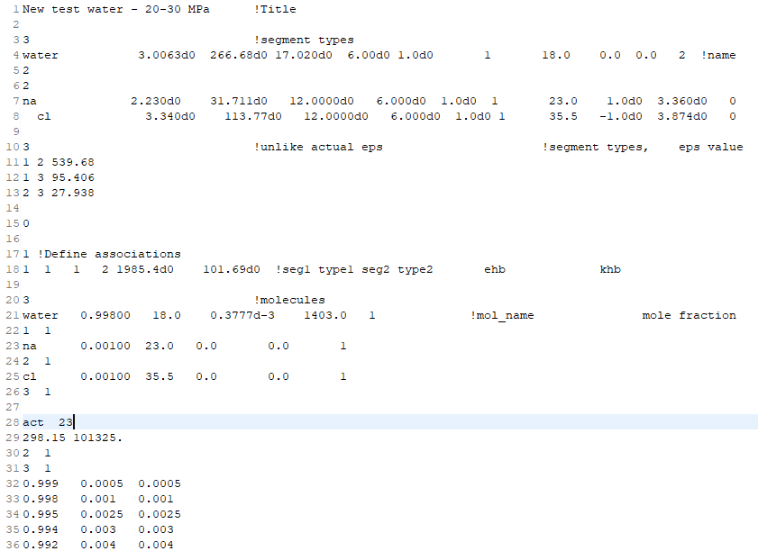

Slide 15
Input file
TITLE
BLANK
SEGMENTS
BLANK
UNLIKE ε
BLANK
UNLIKE λ_{r}
BLANK
ASSOCIATION
BLANK
COMPONENTS
BLANK
CALCULATION DETAILS
Nsegments
Name σ(Å) ε(K) λ_{r} λ_{a} S_{f} N_{seg} mass q σ_{Born} N_{assoc_types}
N_{assoc i}

Slide 16
Input file
TITLE
BLANK
SEGMENTS
BLANK
UNLIKE ε
BLANK
UNLIKE λ_{r}
BLANK
ASSOCIATION
BLANK
COMPONENTS
BLANK
CALCULATION DETAILS
N unlike
segment i segment j ε ij (K)

Slide 17
Input file
TITLE
BLANK
SEGMENTS
BLANK
UNLIKE ε
BLANK
UNLIKE λ_{r}
BLANK
ASSOCIATION
BLANK
COMPONENTS
BLANK
CALCULATION DETAILS
N unlike
segment i segment j λ ij (K)

Slide 18
Input file
TITLE
BLANK
SEGMENTS
BLANK
UNLIKE ε
BLANK
UNLIKE λ_{r}
BLANK
ASSOCIATION
BLANK
COMPONENTS
BLANK
CALCULATION DETAILS
N assoc
segment i assoc_type k segment j assoc_type l E^{HB}(K) K^{HB}(Å³)

Slide 19
Input file
TITLE
BLANK
SEGMENTS
BLANK
UNLIKE ε
BLANK
UNLIKE λ_{r}
BLANK
ASSOCIATION
BLANK
COMPONENTS
BLANK
CALCULATION DETAILS
N molecule types
name mole_fraction mass dt dv number_segment_types
Segment_type number_of_segments

Slide 20
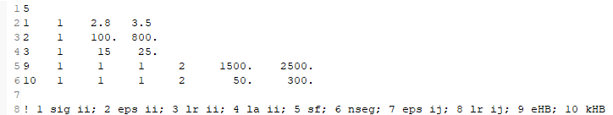
Optimisation input
N parameters to optimise
KEY index_values min max
Key is in manual, test inputs and Input_opt

Slide 21
After September…
I have often altered the code
I believe it should all be working, but….
Any issues / questions with the program, please contact me:
Simon.halstead@gmail.com
My email is in code / manual too!
I am very keen for this code to be of use

